Slide 1
CSC 112: Computer Operating Systems Lecture XX Synchronization
Department of Computer Science,
Hofstra University
Acknowledgement: Lecture slides based on UC Berkeley CS 162: Operating Systems and System Programming

Slide 2
Outlines
Concurrency
Locks
Spinlocks

Slide 3
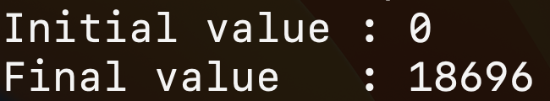
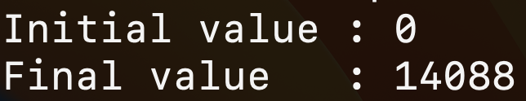
Concurrency
#include <stdio.h>
#include <stdlib.h>
#include "common.h"
#include "common_threads.h”
volatile int counter = 0;
int loops;
void *worker(void *arg) {
int i;
for (i = 0; i < loops;i++) { counter++; }
return NULL;
}
int main(int argc, char *argv[])
{
if (argc != 2){
fprintf(stderr, "usage: threads <loops>\n");
exit(1); }
loops = atoi(argv[1]);
pthread_t p1, p2;
printf("Initial value : %d\n", counter); Pthread_create(&p1, NULL, worker, NULL); Pthread_create(&p2, NULL, worker, NULL); Pthread_join(p1, NULL);
Pthread_join(p2, NULL);
printf("Final value : %d\n", counter);
return 0;
}
Execution results are non-deterministic depending on runtime interleavings of the two threads.
Notes:
On uniprocessors, only one thread executes at a time. However, because of preemption and timesharing, threads appear to run concurrently.

Slide 4
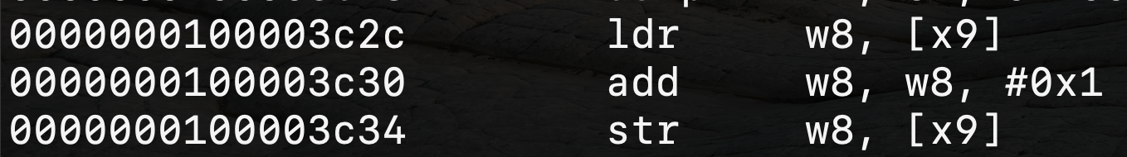
Concurrency
Incrementing counter has 3 instructions
counter++;
ldr w8, [x9]
add w8, w8, #0x1
str w8, [x9]
ldr w8, [x9]
add w8, w8, #0x1
str w8, [x9]
Thread 1
Thread 2
Critical section: a piece of code that accesses a shared resource, i.e., a variable or data structure
Notes:
arithmetic logic unit

Slide 5
Concurrency
Counter
Value
Thread 1
Thread 2
ldr w8, [x9]
add w8, w8, #0x1
str w8, [x9]
100
101
100
ldr w8, [x9]
add w8, w8, #0x1
str w8, [x9]
101
101
str w8, [x9]
101

Slide 6
Concurrency
Concurrency leads to non-deterministic results
Different results even with same inputs
Race condition: Multiple threads of execution update the shared data structure, and the final result depends on the execution order
Programmers must make sure that some high-level code sections are executed atomically
Atomic operation: It completes in its entirety without worrying about interruption by any other potentially conflict-causing thread

Slide 7
Concurrency
The critical-section problem
Problem: ensure that when one thread is executing in its critical section, no other thread is allowed to execute in that critical section
Solution:
Mutual exclusion: Only one thread in critical section at a time
Progress (deadlock-free): If several simultaneous requests, must allow one to proceed
Bounded (starvation-free): Must eventually allow each waiting thread to enter
Notes:
The execution of the critical sections by the threads is mutually exclusive in time
1. Mutual exclusion. If process Pi is executing in its critical section, then no other processes can be executing in their critical sections.
2. Progress. If no process is executing in its critical section and some processes wish to enter their critical sections, then only those processes that are not executing in their remainder sections can participate in deciding which will enter its critical section next, and this selection cannot be postponed indefinitely.
3. Bounded waiting. There exists a bound, or limit, on the number of times that other processes are allowed to enter their critical sections after a process has made a request to enter its critical section and before that request is granted.

Slide 8
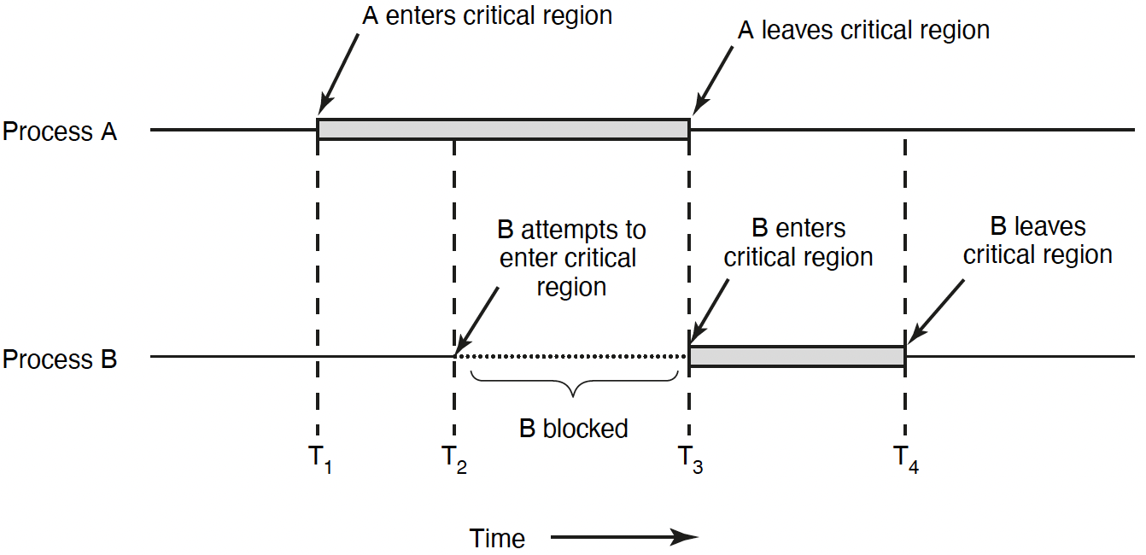
Mutual Exclusion
Notes:
Why do we need to lock a process? When implementing the scheduling algorithm in xv6
p->lock
A simple way to think about p->lock is that it must be held while reading or writing any of the following struct proc fields:
p->state, p->chan, p->killed, p->xstate, and p->pid.
Along with p->state, it prevents races in allocating proc[] slots for new processes.
It ensures that only one core’s scheduler decides to run a RUNNABLE processes.

Slide 9

Concurrency
Count
Value
Thread 1
Thread 2
ldr w8, [x9]
add w8, w8, #0x1
str w8, [x9]
100
101
101
101
ldr w8, [x9]
add w8, w8, #0x1
str w8, [x9]
102
Lock it
102
Mutual exclusion: Only one thread in critical section at a time
Progress (deadlock-free): If several simultaneous requests, must allow one to proceed
Bounded (starvation-free): Must eventually allow each waiting thread to enter
Lock it

Slide 10
Locks
A lock is a variable
Objective: Provide mutual exclusion
Two states
Available or free
Locked or held
lock(): tries to acquire the lock
unlock(): releases the lock that has been acquired by caller
lock_t mutex
void *worker(void *arg) {
int i;
for (i = 0; i < loops;i++) {
lock(&mutex);
counter++;
unlock(&mutex)}
return NULL;
}
Notes:
mutual exclusion

Slide 11
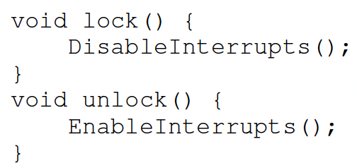
Locks
A good lock:
Mutual exclusion
Fairness: progress, no starvation
Performance: overhead to grab and release lock
An early solution: disable interrupts for critical sections
Problems:
Abused usage
Does not work on multiprocessors
Notes:
Interrupter miss

Slide 12
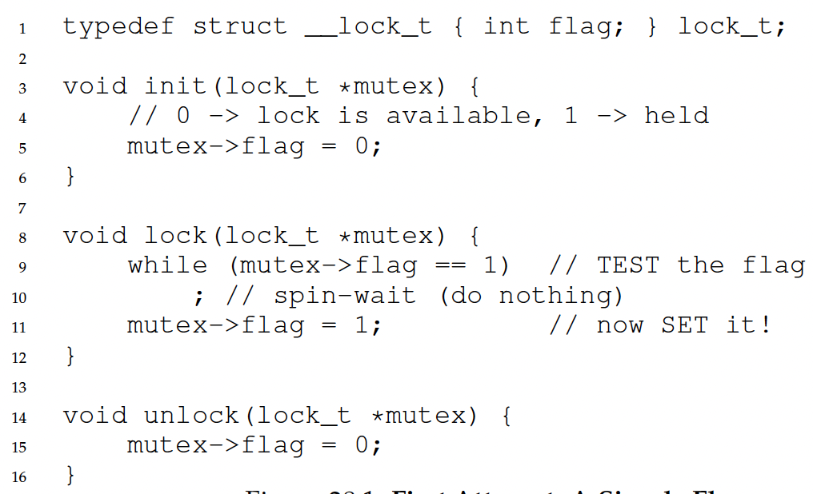
Locks: Naïve Implementation
Using only a single flag variable. This naïve Implementation does not work!

Slide 13
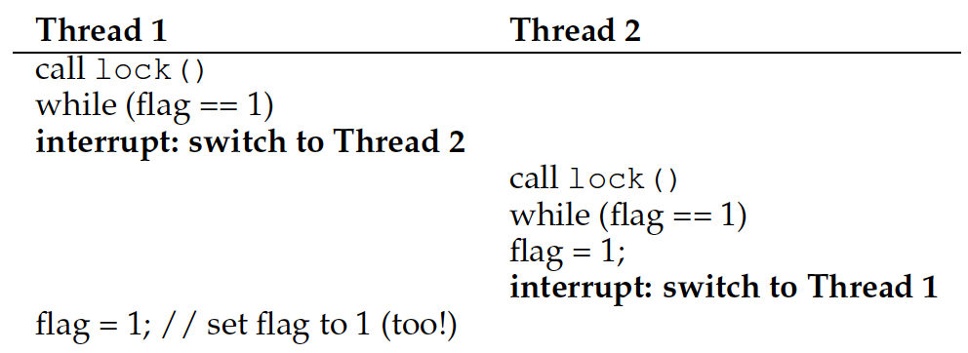
Locks: Naïve Implementation
flag = 0
Both threads grab the lock!!!
Lock operation is not atomic! -> No mutual exclusion
Another problem: performance overhead!

Slide 14
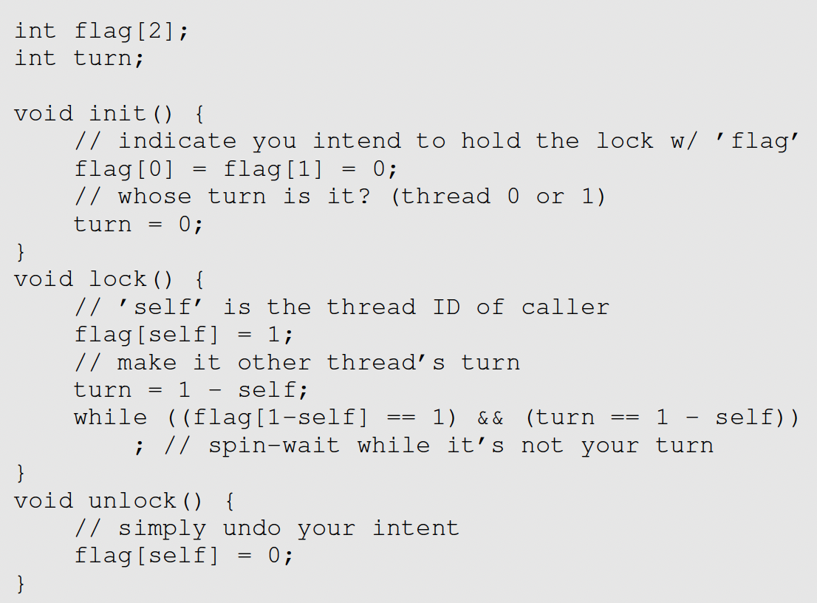
Peterson’s solution
A software-based solution to the critical section problem
Notes:
it provides a good algorithmic description of solving the critical-section problem and illustrates some of the complexities involved in designing software that addresses the requirements of mutual exclusion
turn indicates whose turn it is to enter its critical section
Flag indicate if a thread is ready to enter its critical section
Peterson's solution is restricted to two processes that alternate execution between their critical sections and remainder sections

Slide 15
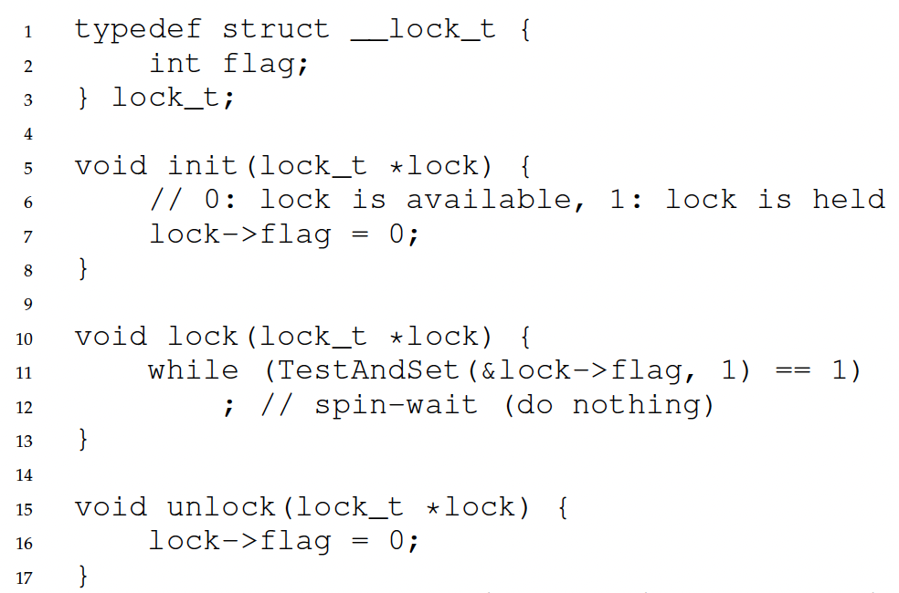
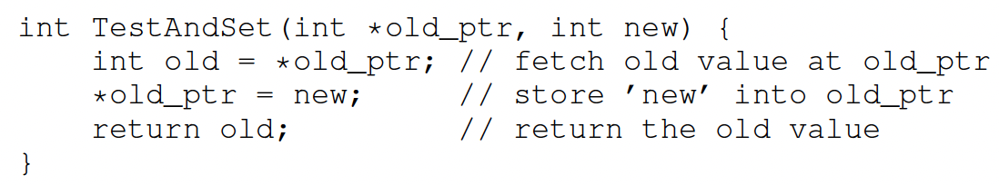
Locks: Test-And-Set
How to provide mutual exclusion for locks?
Get help from hardware!
Many machines provide special hardware instructions to help achieve mutual exclusion
The TestAndSet (TAS) instruction tests and modifies the content of a memory word atomically
Not possible to context-switch within TestAndSet()

Slide 16
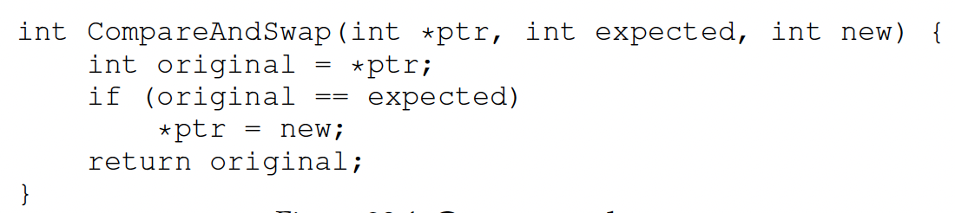
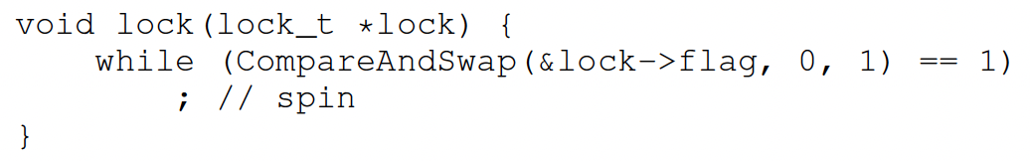
Locks: Compare-And-Swap
A hardware primitive: compare-and-swap
Locks with compare-and-swap

Slide 17
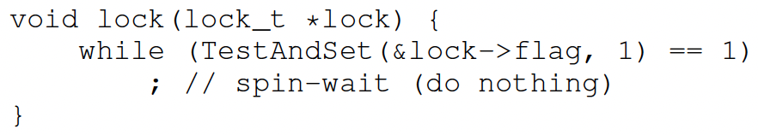
Locks: Busy Waiting
This is based on busy waiting
A thread needs to endlessly check the lock value if the lock is held by others
Lock with busy waiting is called spinlock
Goals:
Mutual exclusion (Yes!)
Fairness (NO!!) May cause starvation
Performance (NO!!)
unlock
lock
lock
lock
unlock
Comp
spin waiting
spin waiting
Comp
spin waiting
Comp

Slide 18
Spinlocks: Unfair
Basic spinlocks are not fair and may have starvation
unlock
lock
lock
lock
unlock
Comp
spin waiting
spin waiting
Comp
spin waiting
Comp

Slide 19
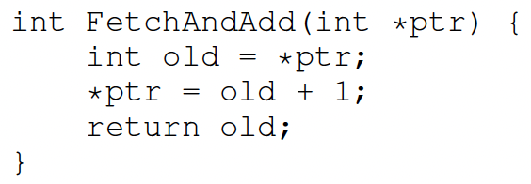
Ticket Lock
A hardware primitive: fetch-and-add
Lock: ticket and turn
Use fetch-and-add on the ticket value
The return value is the thread’s ”turn” value
Unlock:
Increment the turn
Fairness is guaranteed.

Slide 20
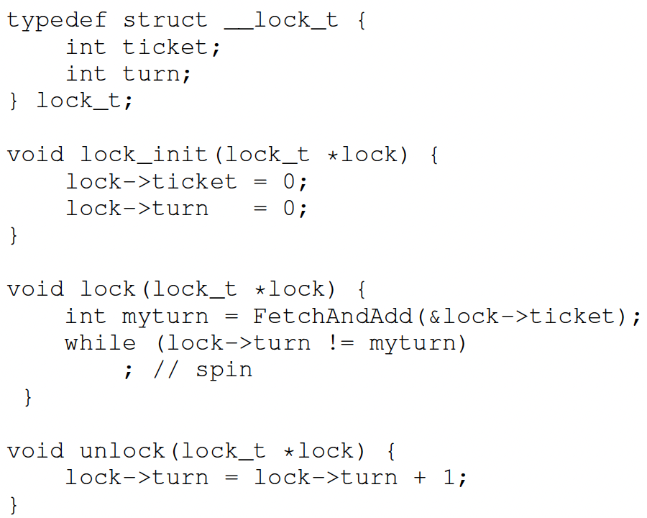
Ticket Lock

Slide 21
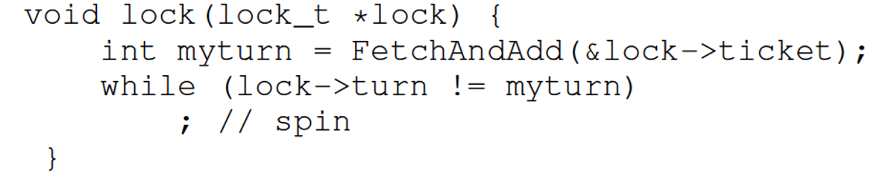
Ticket Lock
Initial value tickets=0 turn=0
 | Ticket | Turn
A lock() | 1 | 0
B lock() | 2 | 0
C lock() | 3 | 0
A unlock()
A lock()
B unlock()
C unlock()
A unlock()
 | myturn
A | 0
B | 1
C | 2

Slide 22
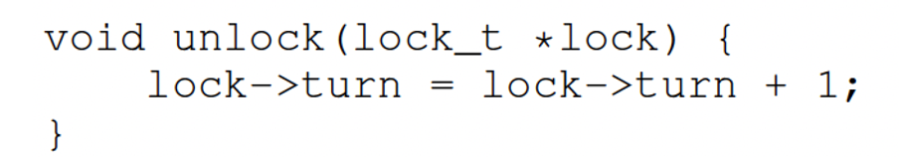
Ticket Lock
Initial value tickets=0 turn=0
 | Ticket | Turn
A lock() | 1 | 0
B lock() | 2 | 0
C lock() | 3 | 0
A unlock() | 3 | 1
A lock() | 4 | 1
B unlock()
C unlock()
A unlock()
 | myturn
A | 3
B | 1
C | 2

Slide 23
Ticket Lock
Initial value tickets=0 turn=0
 | Ticket | Turn
A lock() | 1 | 0
B lock() | 2 | 0
C lock() | 3 | 0
A unlock() | 3 | 1
A lock() | 4 | 1
B unlock() | 4 | 2
C unlock() | 4 | 3
A unlock() | 4 | 4
 | myturn
A | 3
B | 1
C | 2

Slide 24
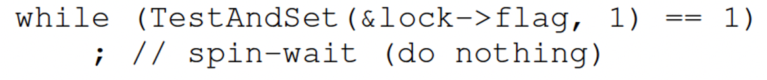
Spinlocks: Performance
Can be fast:
Many CPUs
Locks held a short time
Pros: No context switch
But also, can be slow:
One CPU
Locks held a long time
Cons: Spinning is wasteful

Slide 25
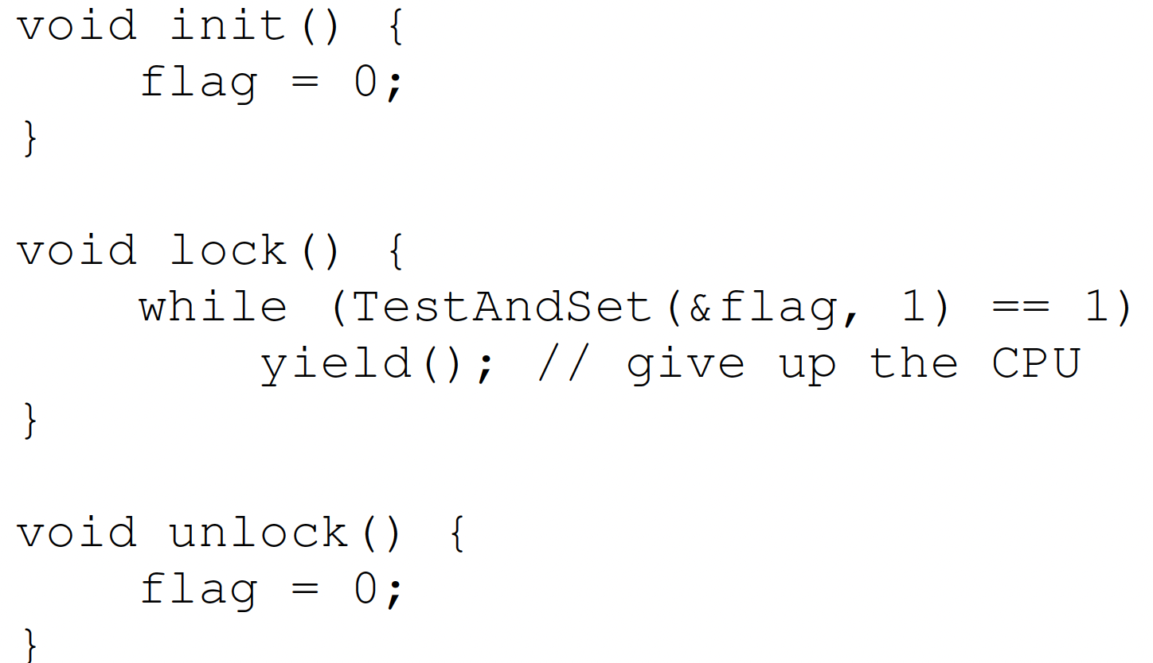
Spinlocks: yield()
Instead of spinning, just give up the CPU to anther process/thread
Even with yield(), spinning is slow with high thread contention
Notes:
yield is simply a system call that moves the caller from the
running state to the ready state, and thus promotes another thread to
running. Thus, the yielding thread essentially deschedules itself.
a relatively large number of threads attempting to acquire the lock

Slide 26
Spinlocks: Locks with Queue
Locks with queue
Sleep and put thread on a queue instead of spinning
This can guarantee that starvation does not happen as long as all threads will relinquish locks
An example from Solaris
Park(): put the calling thread to sleep
Unpark(ThreadID): to walk up a specific thread with ThreadID

Slide 27
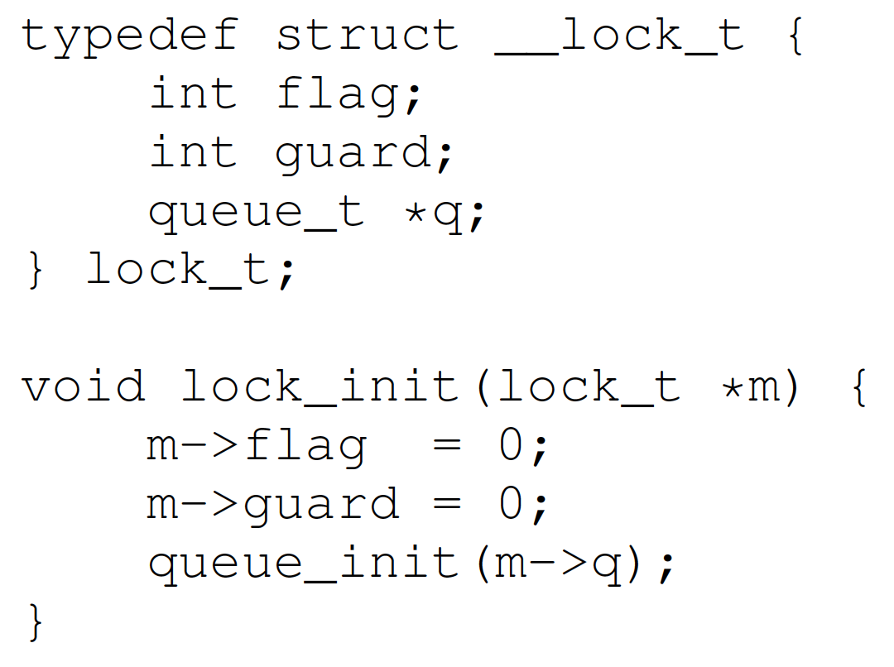
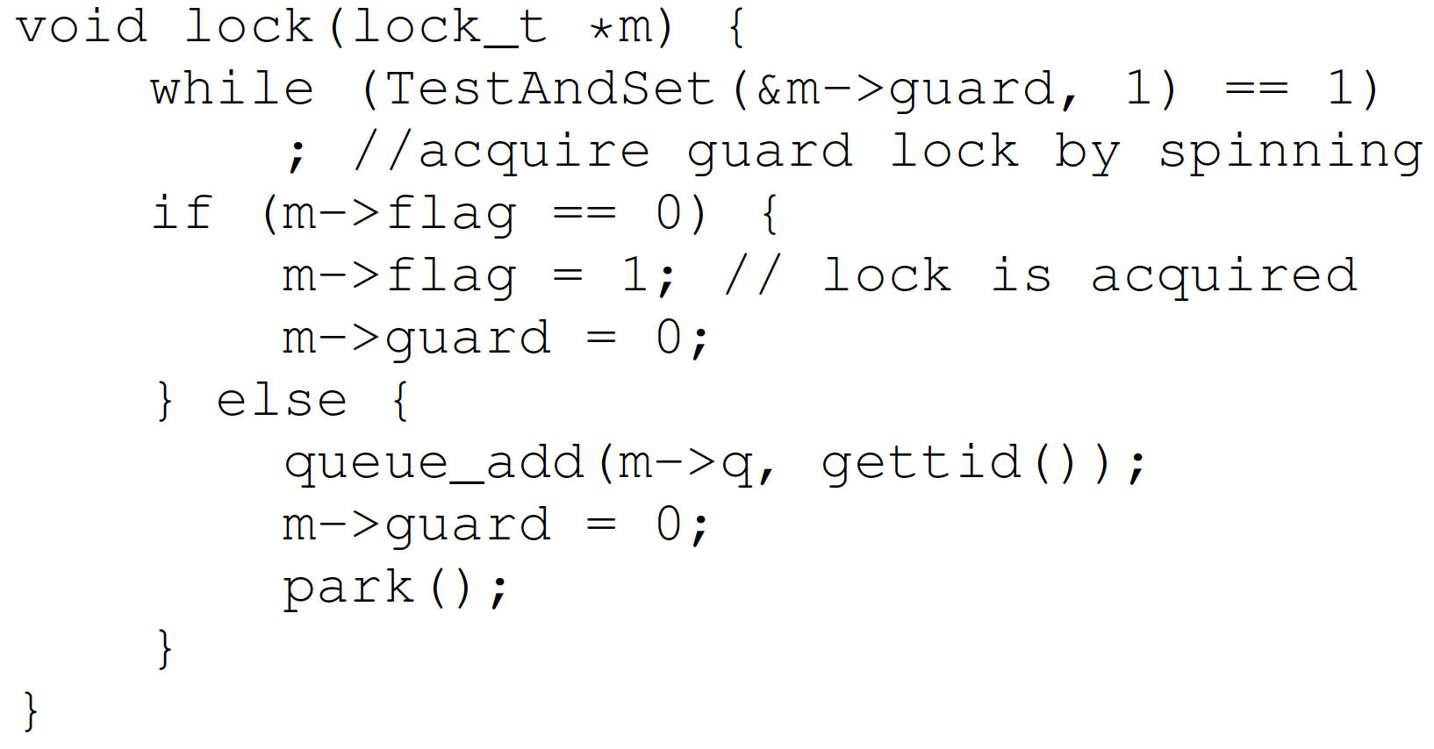
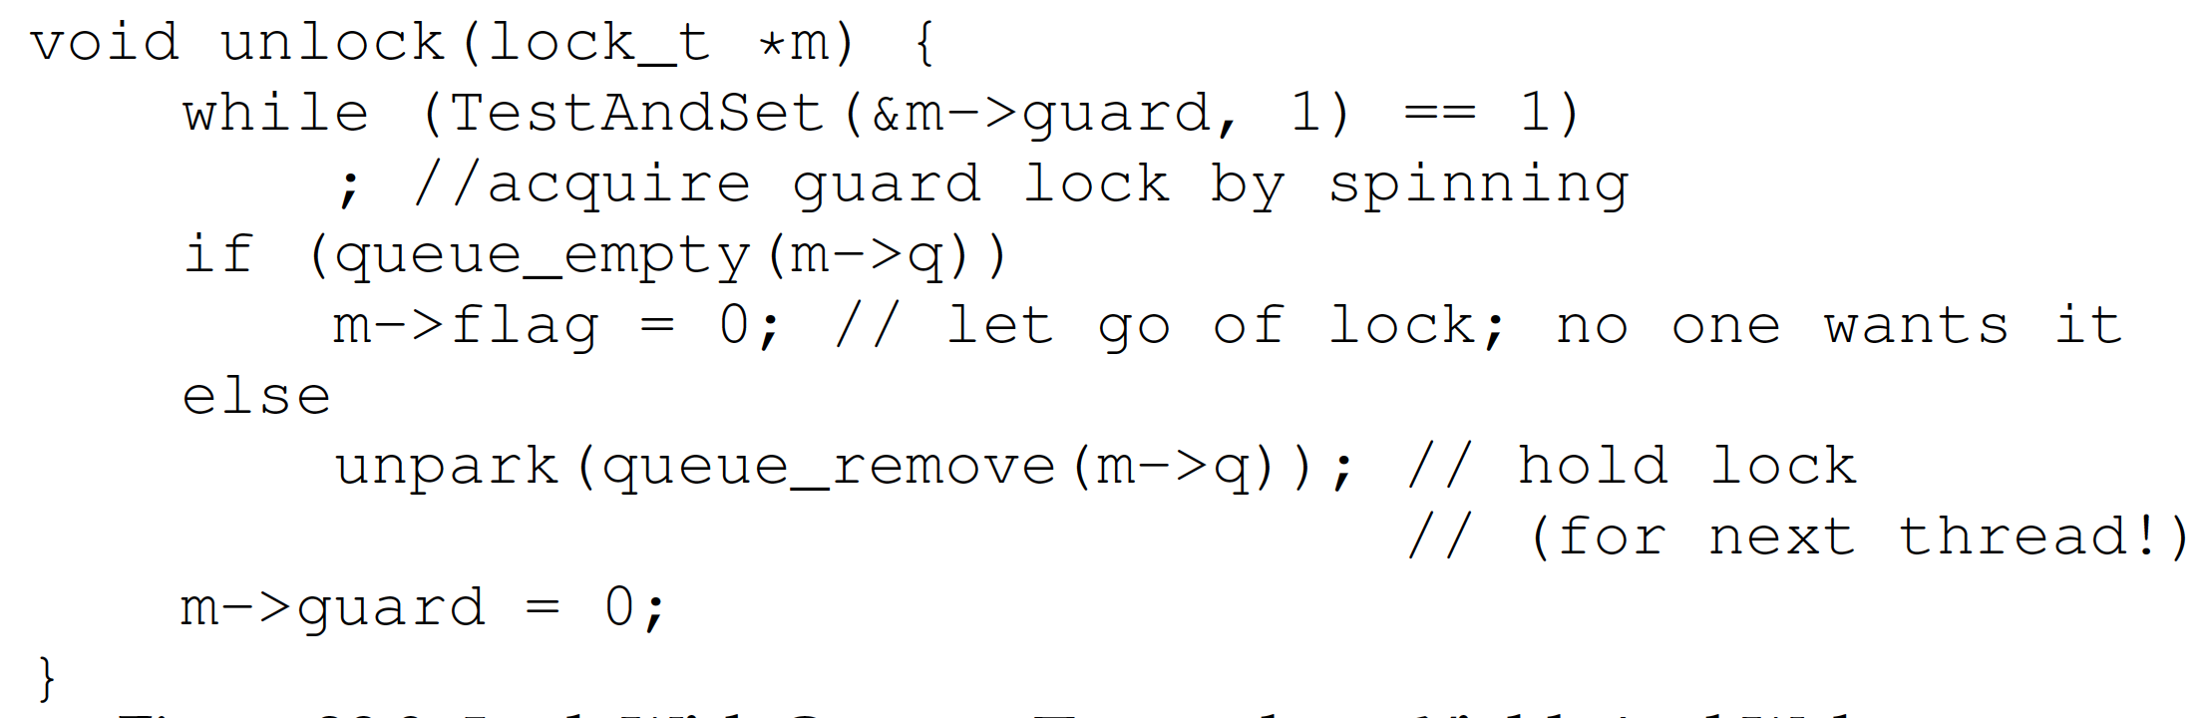
Spinlocks: Locks with Queue
Notes:
Guard is used to prevent races in updating the queue.

Slide 28
Spinlocks: Two Phase locks
Lock released quickly ▶︎ Spin-wait
Lock released slowly ▶︎ Sleep/block
Two phase lock is a hybrid approach that combines both spin-wait and sleep/block
First phase: the lock spins for a while
Second phase: if the lock is not acquired in the first phase, put the calling thread to sleep.
Adaptive Mutexes: If a thread has a locked adaptive mutex and the process/thread holding the adaptive mutex is running, the adaptive mutex executes busy waiting. Otherwise, it just blocks the thread.

Slide 29
Summary
Locks: Provide a mutual exclusion
Spinlocks:
Test-And-Set()
Compare-and-swap()
Yield()
Locks with Queue
Two phase locks
Adaptive mutex

Slide 30
Summary
More cores fabricated on a single CPU
New abstraction: thread
Sharing address space
Concurrency: non-deterministic
Mutual exclusion

